Slide 1
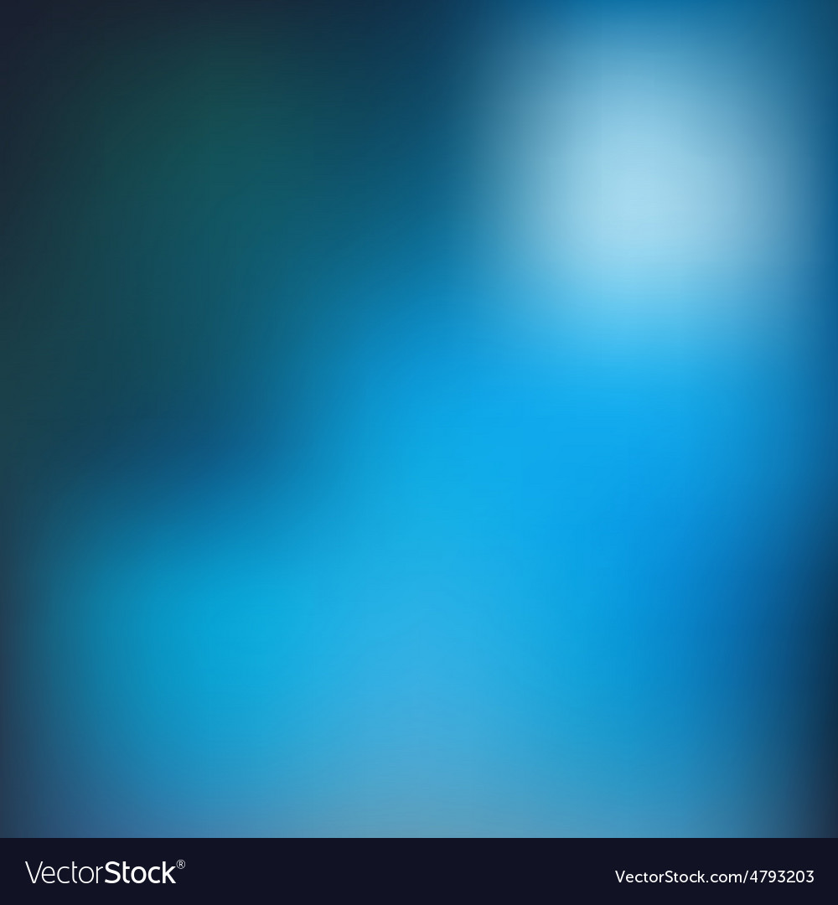

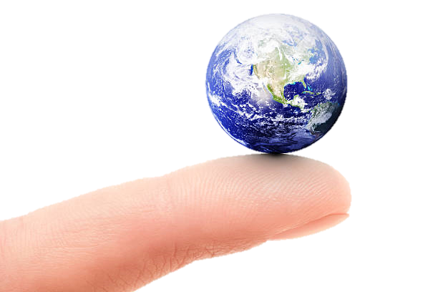
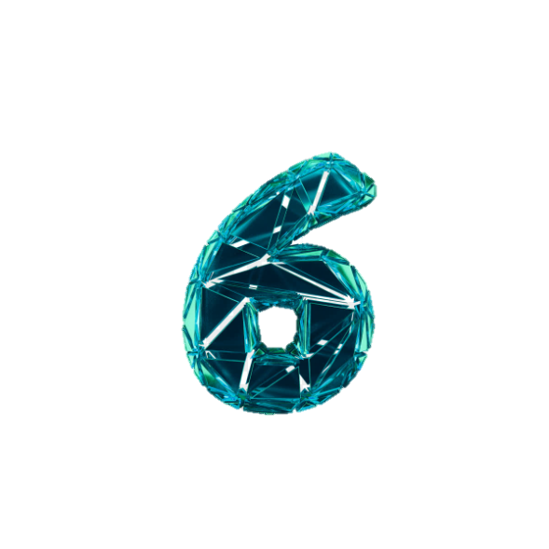
Prasad Institute of technology
Department of Computer Science & Eng.
Presents
A magical presentation on
The
^{th} Sense Technology
Presented By:- Vikash Kumar
Ritik Rai

Slide 2
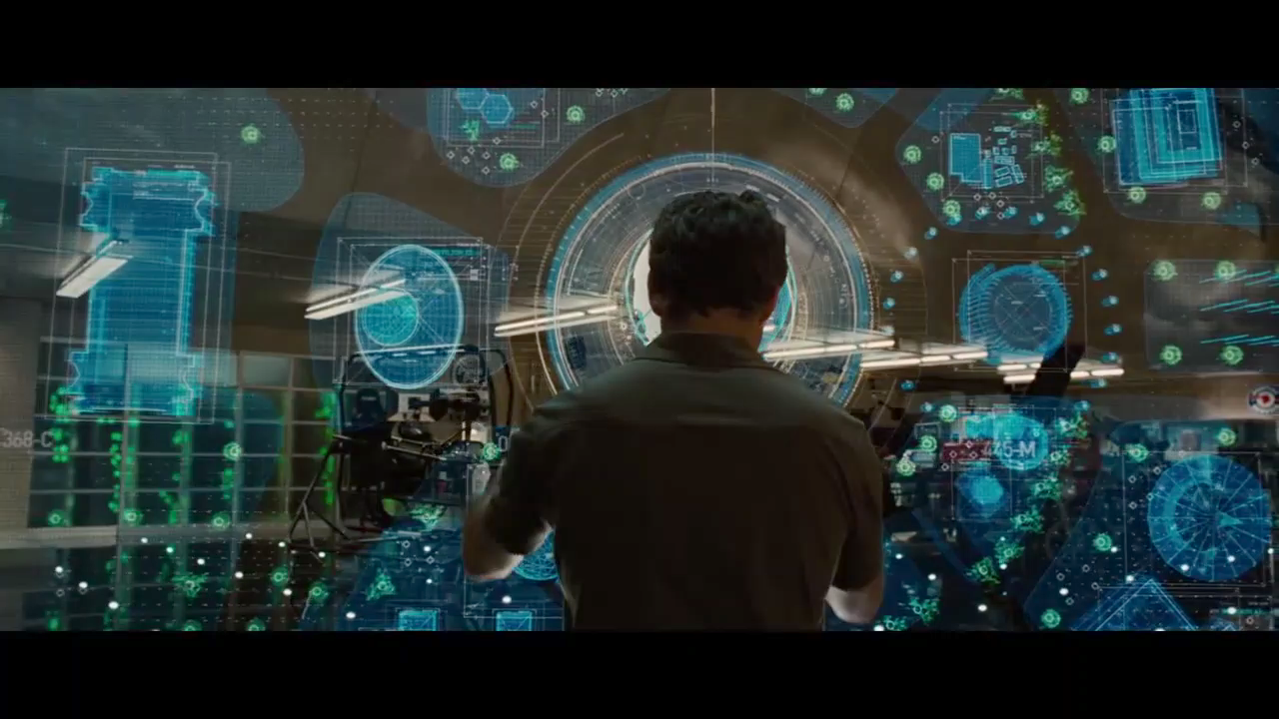

Slide 3
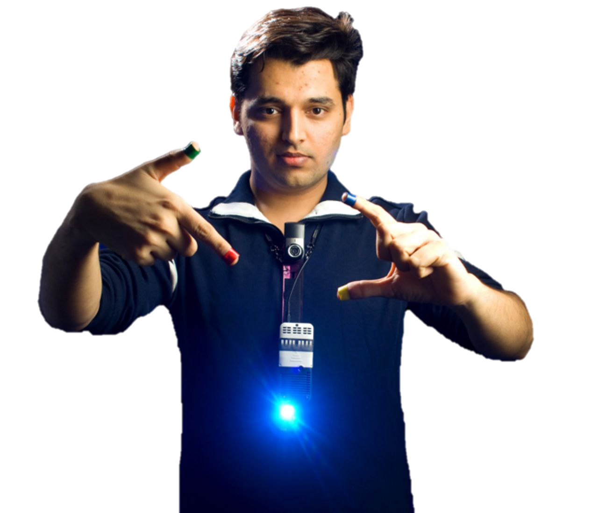
INTRODUCTION
Sixth sense is a wearable gestural interface that augments the physical world around us with digital information and lets us use natural hand gestures to interact with that information.
Steve mann is considered as the father of Sixth sense technology who made wearable computer in 1990. He implemented this tech as that neck worn technology with a camera system.
Mann originally referred it as “Synthetic Synaesthesia of Sixth Sense”
Later, his work was carried forwarded by PRANAV MISTRY (Ph.D student in MIT media Lab.)

Slide 4

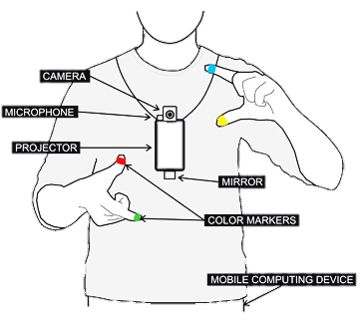
The devices which are used in 6th sense technology.
Camera
Colored Marker
Mobile Component
Mirror
Projector

Slide 5

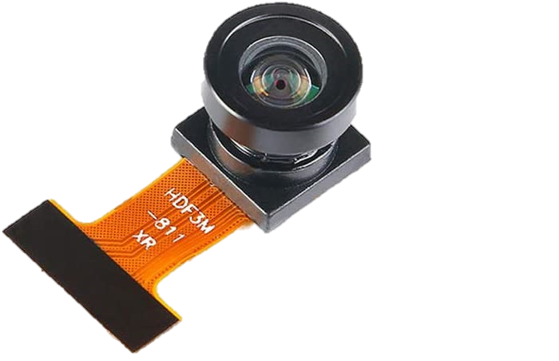
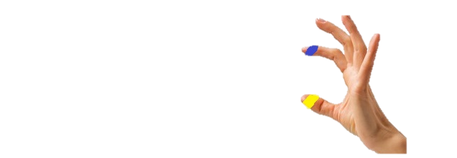
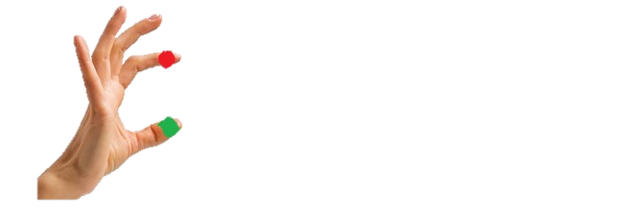
Camera:-
Captures an object in view and tracks user’s hand gestures.
Sends the data to Smartphone.
It acts as a digital eye, connecting
You to the world of digital information
Color Markers:-
It is the tip of the user’s fingers.
Marking the user’s fingers with red ,yellow green and blue tape helps the webcam recognize gestures.
The movements and arrangements of these makers are interpreted into gestures that act as interaction instructions for the projected application interfaces.

Slide 6
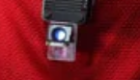
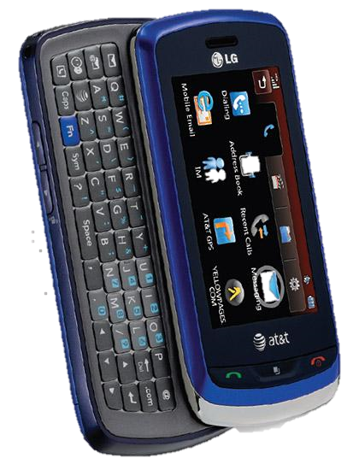
Mirror:-
A the use of the mirror is significant as the projector downwards from the neck.
A web-enabled smart phone in the user’s pocket processes the video data
Other software searches the web interprets the hand gestures.
Smart phone:-
A wed-enabled smart phone in the user’s pocket processes the video data.
Other software searches the web and interprets the hand gestures.

Slide 7
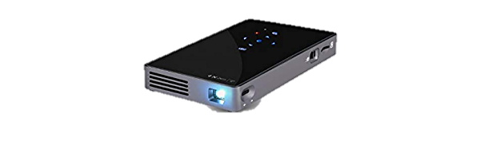
Projector:-
The projector projects visual information enabling surfaces and physical objects to be used as interface
The project itself contains a battery inside , to power up
A tiny LED projector displays data send from the smart phone on any surface in view – object wall or person.

Slide 8
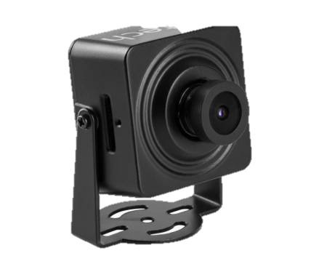
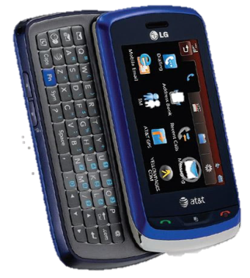
Block Diagram
The working of The sixth sense device
Images
Pictures
Gestures
Info on
Surface

Slide 9
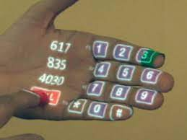
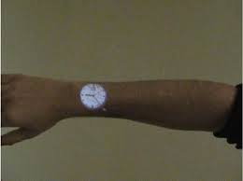
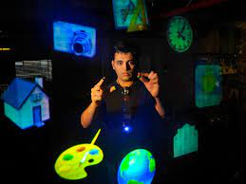
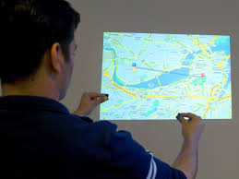
In life Usage
Making call with virtual keypad
See time
Multimedia access
Calling up Maps

Slide 10
Applications
Make a call :-
You can use the sixth sense to project a keypad onto your hand ,them use that virtual keypad to make a call.
Check the time:-
Draw a circle on your wrist to get a virtual that give you the correct time
Create multimedia reading experiences
Sixth sense can be programmed to project related videos onto newspaper articles you are reading

Slide 11
Take pictures :-
If you fashion your index fingers and thumbs in to a square (“framing ” gesture), the system will snap a photo.
After taking the desired no. of photos, you can project them onto a surface and use gestures to “zoom in” or “zoom out” them.
Drawing application :-
The drawing application lets user draw on any surface by tracking the fingertip movements of user’s index finger.

Slide 12
Future Enhancements
To get rid of color markers
To incorporate camera and projector inside mobile computing device.
To have 3D gesture tracking.
To make Sixth Sense works as fifth Sense for diabled person.

